Slide 1
Presentation 16
Staff training and certification
The objectives of training and certification
The training and certification process
Determine professional knowledge requirements
Determine training and updating needs
Planning training and updating programs
Define positions requiring certification
Planning the certification processes
Delivery of training and certification programs
Follow-up subsequent to training and certification

Slide 2
The objectives of
training and certification
*** To develop the knowledge and skills new staff
need to perform software development &
maintenance tasks.
*** To assure conformity to the organization’s
standards for software products (documents
and code).
*** To update the knowledge and skills of veteran
staff.
*** To transmit knowledge of SQA procedures
*** To assure that candidates for key positions are
adequately qualified

Slide 3
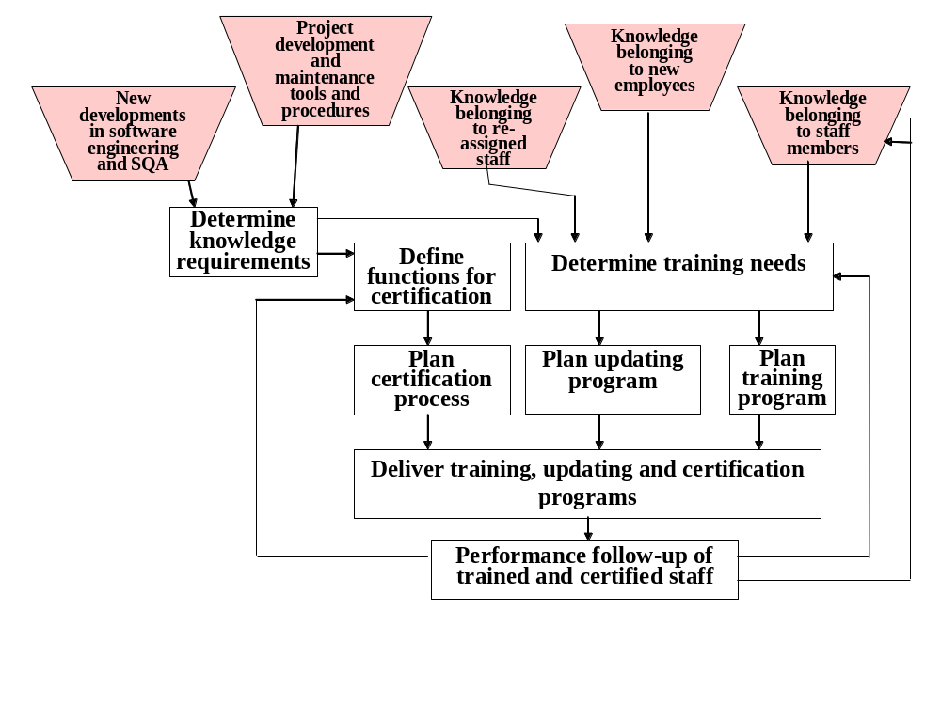
The training and
certification process

Slide 4
Determine professional knowledge requirements
Profession: system analyst, programmer, software development team leader, programming team leader, software maintenance technician, software tester, software testing team leader.
Knowledge requirements: knowledge and skills of software engineering topics; knowledge of SQA topics.

Slide 5
Determine training and updating needs
Training: for new employee
Retraining: for employees assigned to new positions or receiving new assignments
Updating: for staff members as demanded by their position
Follow-up provides major input in redefining training needs.

Slide 6
Positions requiring certification
Examples: software development team leader, programming team leader, software maintenance technician, software testing team leader, internal quality auditor.
- Varies by firms or organization.

Slide 7
Typical certification
requirements
∗∗ Professional education: academic or technical
degrees
∗∗ Internal training courses
∗∗ Professional experience in the organization (may be
partially or completely replaced by experience in other
organizations)
∗∗ Assessment of achievements and ability in periodic appraisals
** Evaluation by the candidate’s direct superior
∗∗ Demonstration of knowledge and skills by means of
a test or a project
∗∗ Mentor’s supervision for a specified period of time

Slide 8
Functions of the
certification committee
∗∗ To perform certification process and grant
certification to those who qualify
∗∗ To follow-up certification activities (such
as mentoring) carried out by others
∗∗ To update certification requirements in
response to developments in the
organization as well as the profession
** To revise the list of positions requiring
certification

Slide 9
Delivery of training and certification programs
- Topics include software engineering, SQA & management skills, as needed by the firm.
Courses can be short lectures, demonstrations, lengthy courses.
Can be conducted by organization’s training unit, academic institutions, vocational institutions.

Slide 10
Follow-up of trained and certified staff performance
Collection of regular performance metrics
Questionnaires completed by trained and certified staffs, superiors, customers and others.
Analysis of outstanding achievements & failures.
Specialized review of software products

